Slide 1


Slide 2


Slide 3
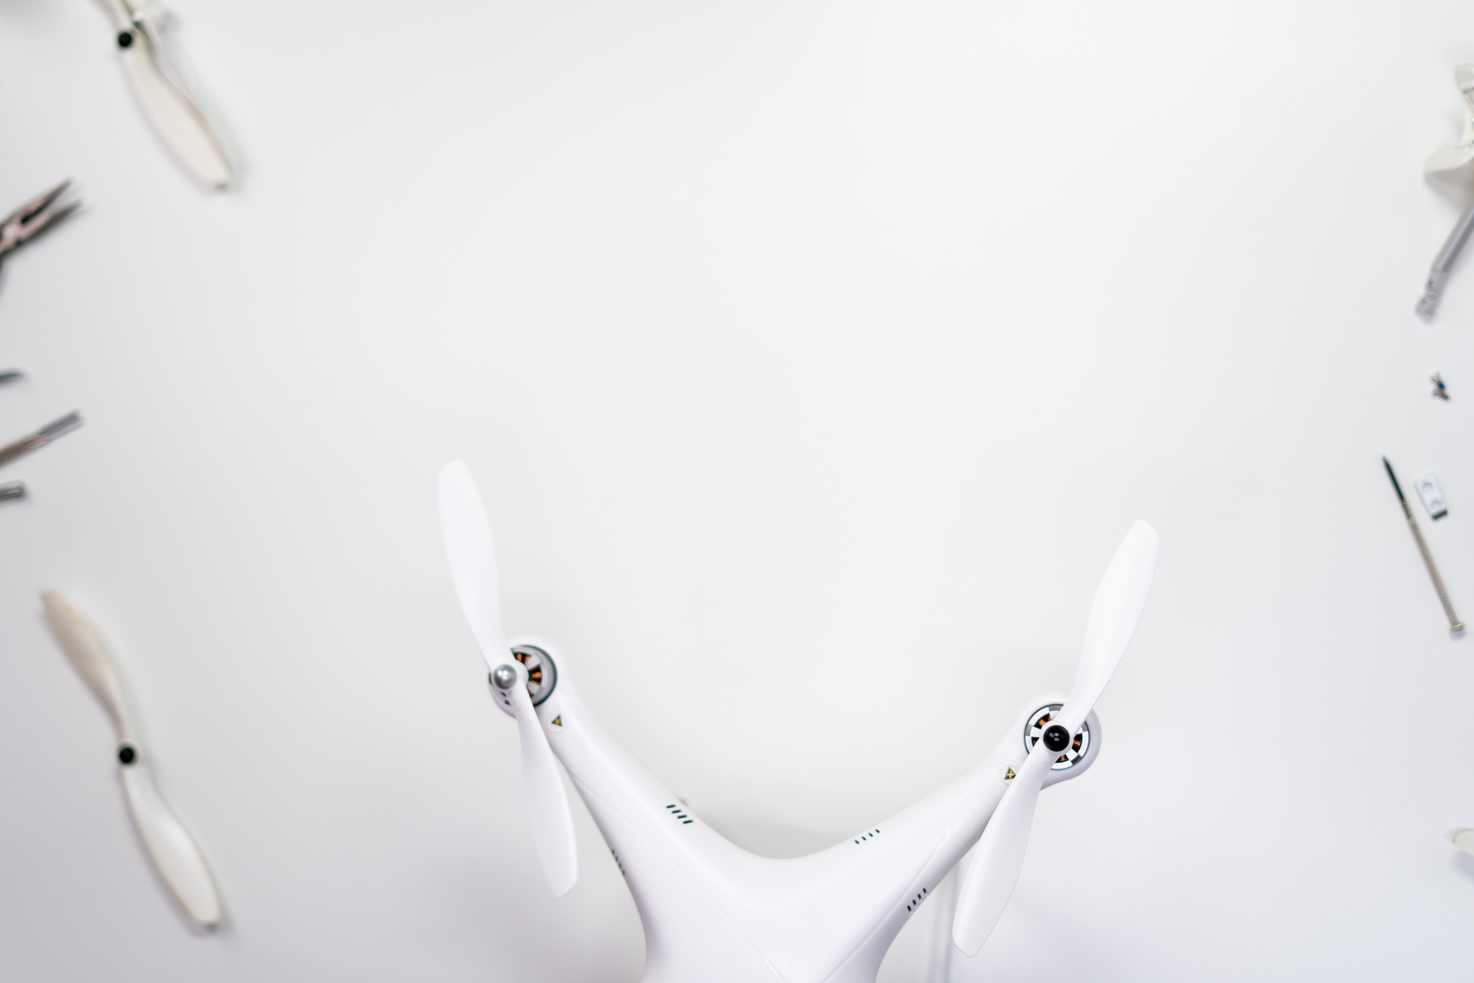

Slide 4


Slide 6


Slide 7

ADDRESSING THE COMPLEXITIES
While technology offers immense benefits, it also brings challenges that require careful navigation. Issues such s privacy violations, cybersecurity threats, and environmental concerns highlight the need for responsible innovation.

Slide 8



Slide 10
EMAIL
hello@reallygreatsite.com
ADDRESS
123 Anywhere St., Any City

